Slide 1

Limits to Distributions: Abiotic factors
See chapter 5 of Krebs (2014)

Slide 2
Limits to Distributions: Abiotic factors
Module Learning Outcomes:
Knowledge and Understanding
1. Demonstrate critical awareness of the rapidly changing status of species in the natural environment, the implications for ecosystem services, and the approaches to addressing these problems in different ecosystems.
2. Integrate knowledge of ecological processes with the socio-political dimensions of conservation problems.

Slide 3
Limits to Distributions: Abiotic Factors
Climate
Temperature
Moisture
Microclimate
Topography
Light
Plus -
Soil / rock type
pH level
Pollutants, etc

Slide 4
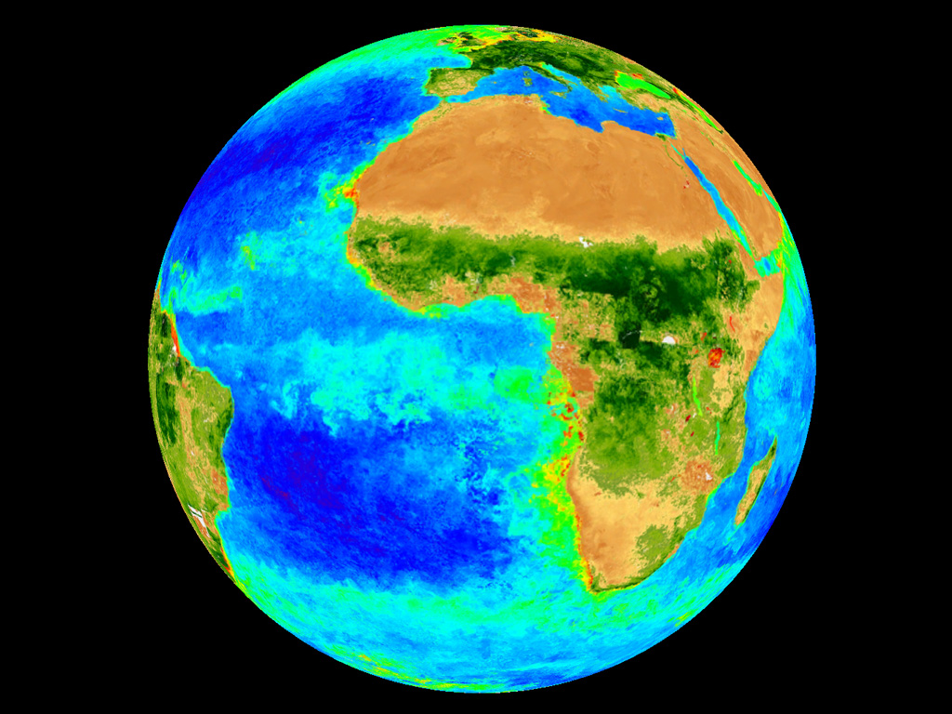
Two basic variables cause the large differences in temp. around the earth
Incoming solar radiation
Distribution of land & water
Notes:
4

Slide 5
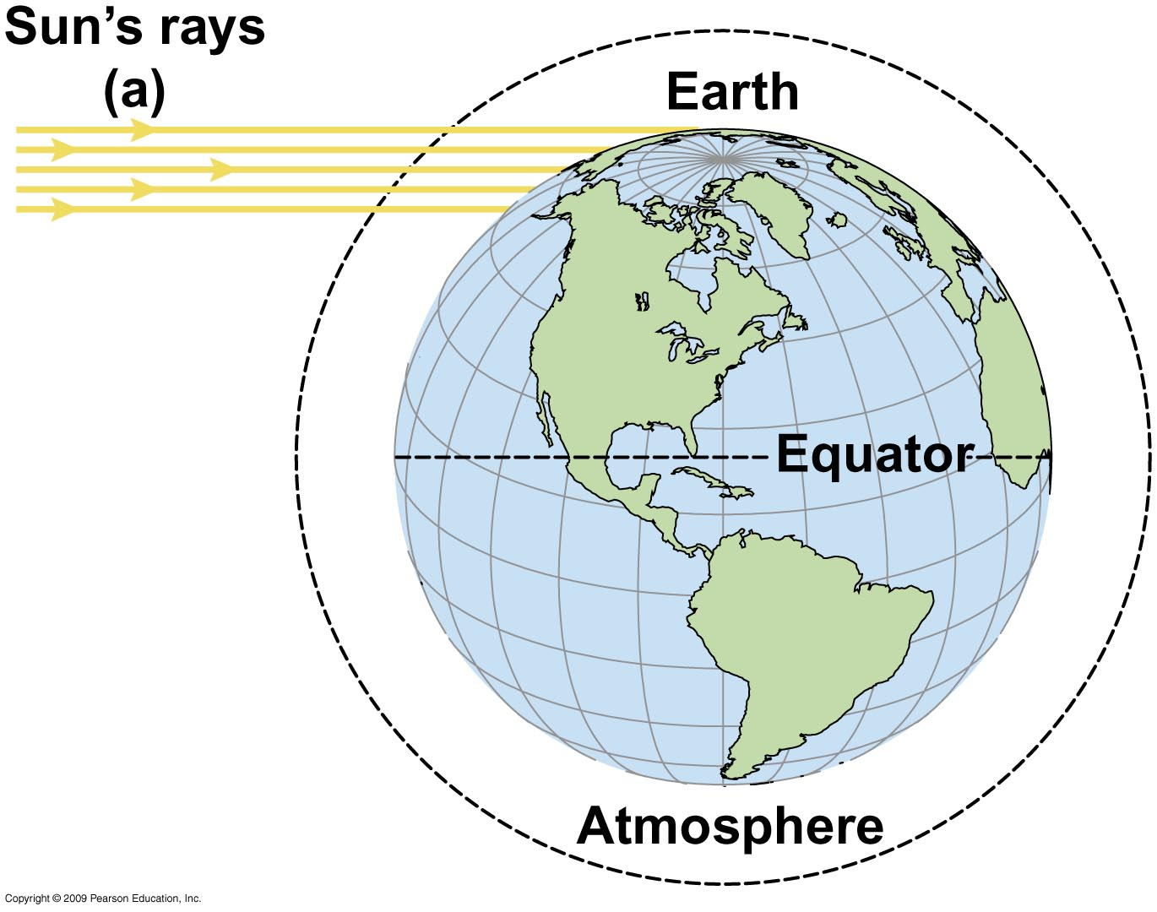
Insolation is lower at high latitudes…
less heat per unit of surface area

Slide 6
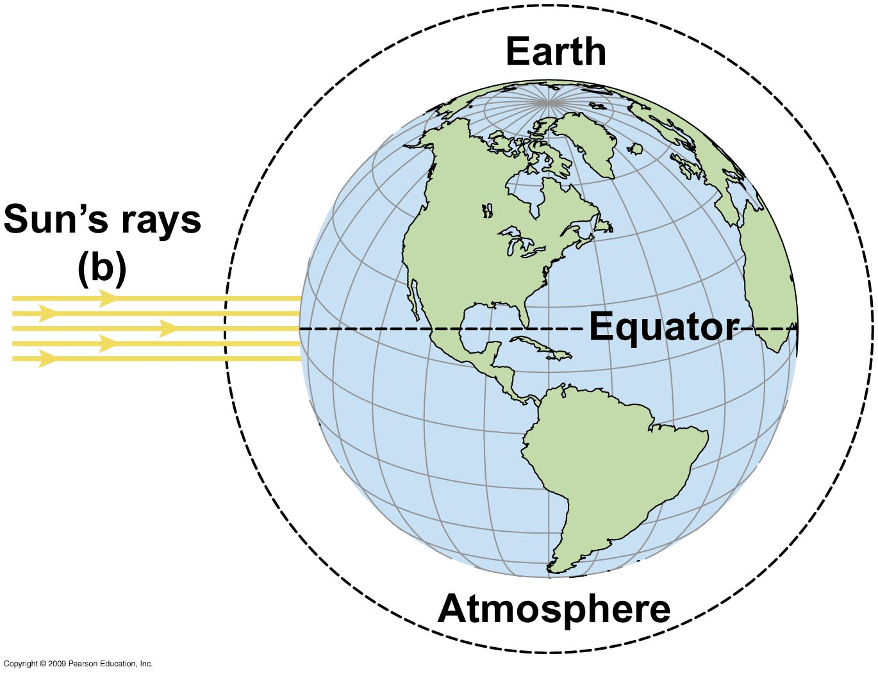
…and highest at the equator
overall insolation annually is only about 40% at poles cf. equator

Slide 7
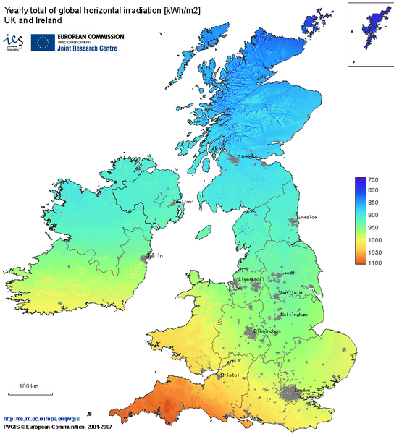
http://mappery.com/maps/United-Kingdom-Solar-Radiation-Map.mediumthumb.png
Notes:
7

Slide 8
Microclimate
Variations may be considerable even within a small region / habitat / site / individual tree
especially for small organisms

Slide 9

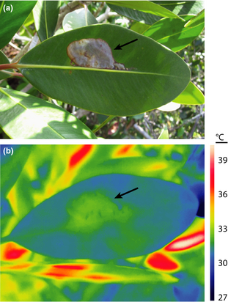
Effect of herbivory on leaf surface temperature. (a) Damage caused by a leaf mining caterpillar (Phyllonorycter sp.) (b) Corresponding infrared image shows that damaged leaf area is warmer than the intact leaf surface (32·7 vs. 30·9 °C)
Microclimate
Pincebourde & Woods (2012) Functional Ecology 26: 844-853
Notes:
Pincebourde & Woods (2012) Functional Ecology 26: 844-853 Climate uncertainty on leaf surfaces: the biophysics of leaf microclimates and their consequences for leaf-dwelling organisms.
Effect of herbivory on leaf surface temperature. (a) Picture of damage caused by a leaf miner caterpillar (Phyllonorycter sp.) on a leaf of Cluzia sp. in a tropical forest (photo Sylvain Pincebourde). (b) The corresponding infrared image (thermography) shows that the damaged leaf area is warmer than the intact leaf surface (32·7 vs. 30·9 °C, respectively) (photo Sylvain Pincebourde). (c) Infrared image (thermography) of a fifth‐instar caterpillar of Manduca sexta feeding on a leaf of Datura wrightii, in southern Arizona, showing that the leaf temperature increase can be limited to the attacked leaf portion (photo H. Arthur Woods).
© IF THIS IMAGE HAS BEEN PROVIDED BY OR IS OWNED BY A THIRD PARTY, AS INDICATED IN THE CAPTION LINE, THEN FURTHER PERMISSION MAY BE NEEDED BEFORE ANY FURTHER USE. PLEASE CONTACT WILEY'S PERMISSIONS DEPARTMENT ON PERMISSIONS@WILEY.COM OR USE THE RIGHTSLINK SERVICE BY CLICKING ON THE 'REQUEST PERMISSION' LINK ACCOMPANYING THIS ARTICLE. WILEY OR AUTHOR OWNED IMAGES MAY BE USED FOR NON-COMMERCIAL PURPOSES, SUBJECT TO PROPER CITATION OF THE ARTICLE, AUTHOR, AND PUBLISHER.

Slide 10
Land & sea absorb heat differently
Leads to climatic variation within the same latitude
Land heats quickly & cools rapidly cf. water
Water heats & cools more slowly
high specific heat capacity

Slide 11
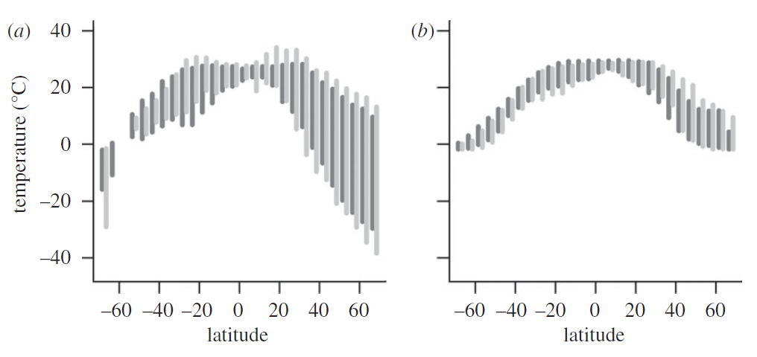
Winter to summer temperature range is smallest at low latitudes & over oceans
land
sea
Dark grey bars: Americas; light grey bars: Old World.
Dark grey bars: Pacific Ocean; light grey bars: Atlantic and Indian Oceans.
Ranges of surface temperatures (data from all continents combined)
Sunday et al. (2010) Proc. National Academy of Sciences USA 102(23): 8245-8250
Notes:
Figure 1. Range of surface temperatures for (a) land and (b) sea. Bars indicate the inner 95% quantile of mean monthly temperatures
from long-term climatologies, sampled over all longitudes, on a 58 58 grid basis (land: 1961–1990 [26]; sea: 1960–
1989 [27]). (a) dark grey bars: Data from NewWorld (North and South America, and adjacent polar regions); light grey bars: OldWorld (other continents
and adjacent polar regions) land areas are shown separately.
(b) dark grey bars: Pacific Ocean; light grey bars: Atlantic and Indian Oceans.

Slide 12
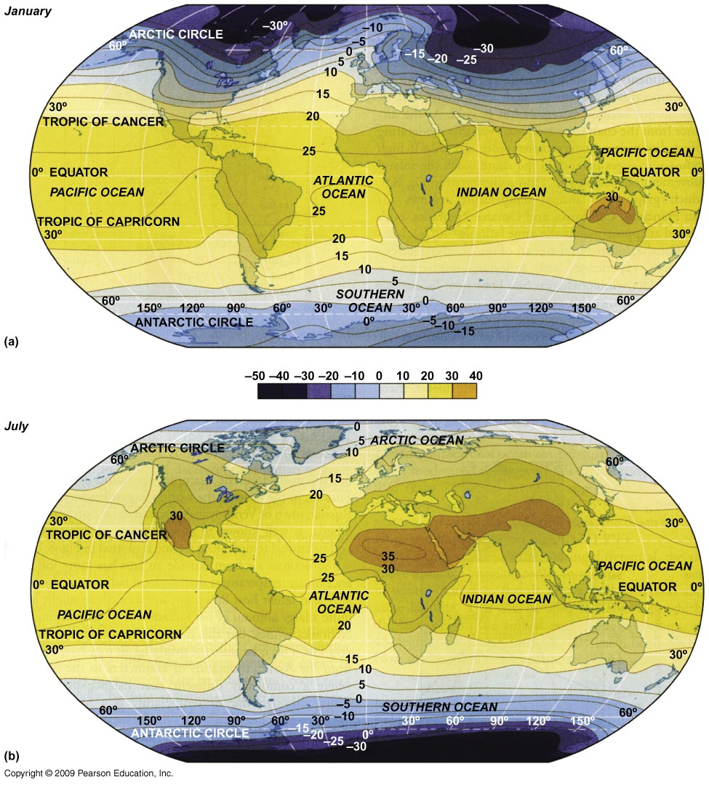
Winter to summer temperature range… …is smallest at low latitudes & over oceans
Average Jan. (top) and July temperatures

Slide 13
Limits to Distributions: Abiotic Factors
Part i
Climate
Temperature
Microclimate
Part ii
Climate
Moisture
Topography
Climate change
Part iii
Limits of tolerance
Part iv
Light

Slide 14
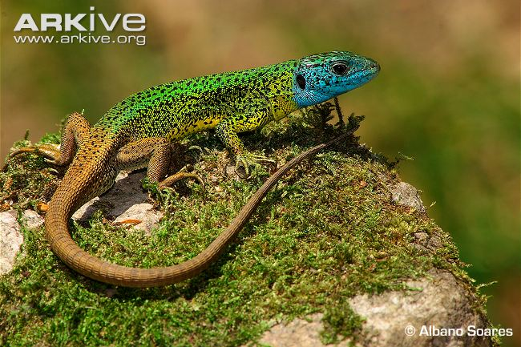
Water (alone or with temperature) is most important physical factor for terrestrial organisms
Humidity
Important in controlling water loss
Water intake
In food or drink
Soil water

Slide 15
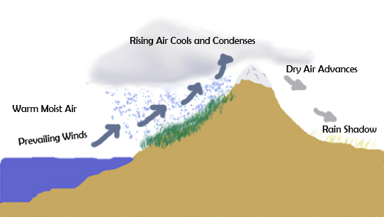
Mountains
Highland areas intercept more rainfall
…and leave a rain shadow on leeward side
Notes:
Image: http://en.wikipedia.org/wiki/File:Rainshadow_copy.jpg

Slide 16
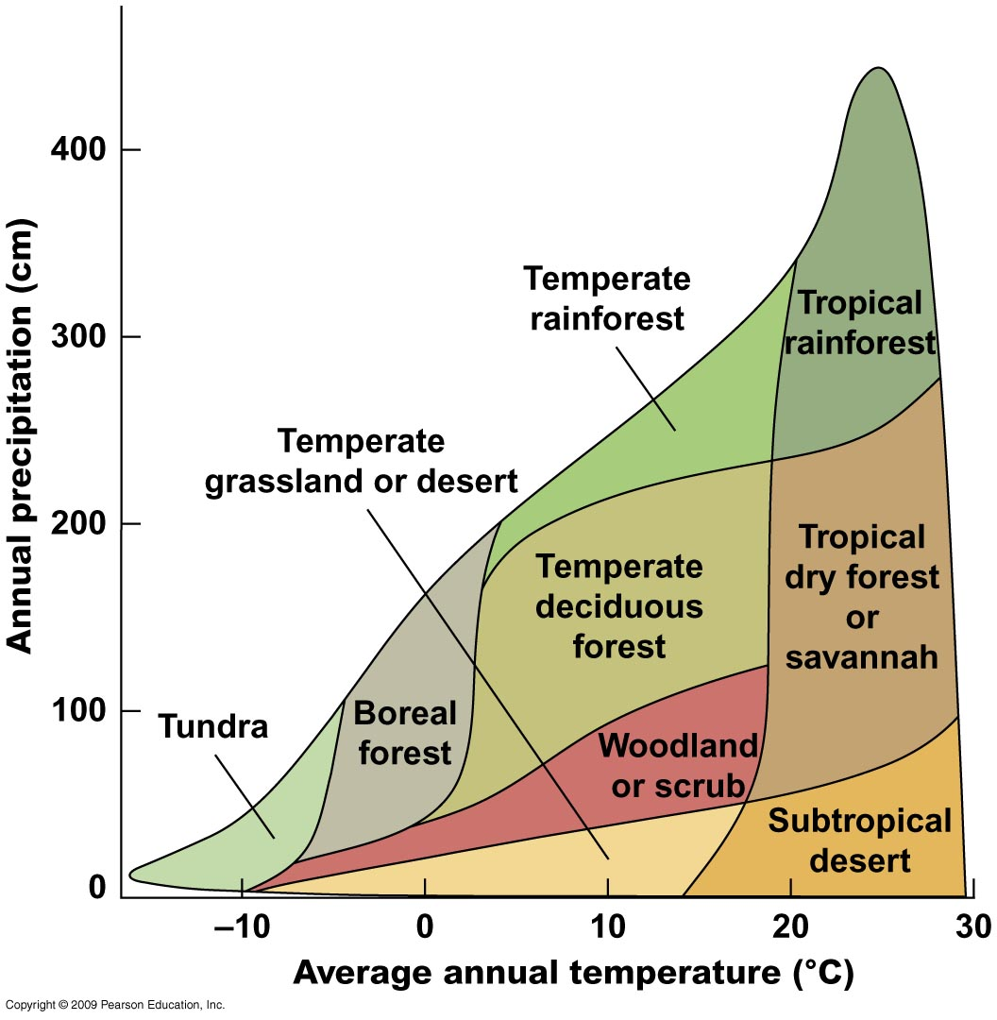
Vegetation is a product of climate
Terrestrial vegetation classes in relation to precipitation & temperature

Slide 17
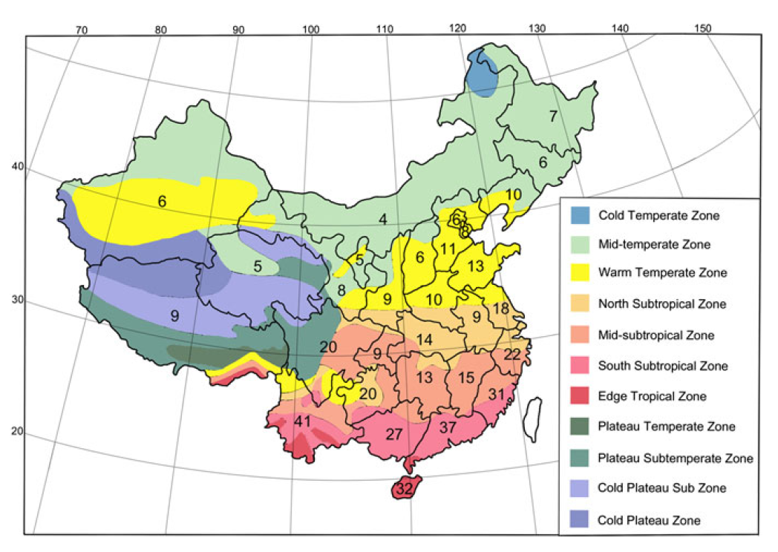
Climatic zones and intensity of plant invasions in China. Black lines indicate provincial boundaries. Numbers are an index of number of casual and naturalized species/log in each province. Colors designate different climatic zones across China.
Wu et al. (2010) Biol Invasions 12: 2179-2206

Slide 18
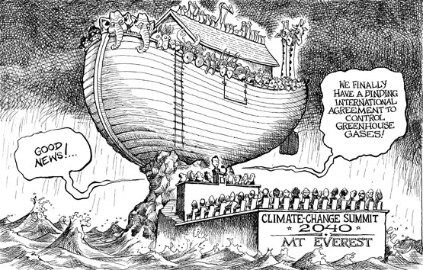
Climate change & distributions
Notes:
http://aidontheedge.info/category/strategy/page/2/

Slide 19
UK birds: extinction risk under climate change
Data from Ausden et al. (2015) British Wildlife 26(3): 161-174 (Table 1)
Notes:
Data from Ausden et al. (2015) British Wildlife 26(1): 161-174 (Table 1)

Slide 20
UK birds: establishment chance under climate change
Data from Ausden et al. (2015) British Wildlife 26(3): 161-174 (Table 2)
Notes:
Data from Ausden et al. (2015) British Wildlife 26(1): 161-174 (Table 2)

Slide 21
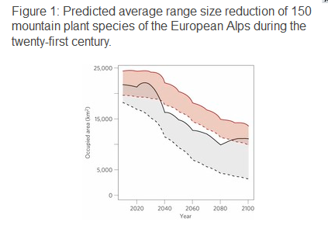
Occupied area (km²)
2020 2040 2060 2080 2100
Year
(Colours and lines represent various different models.)
Dullinger et al. (2012) Nature Climate Change 2: 619–622
Notes:
http://www.nature.com/nclimate/journal/v2/n8/full/nclimate1514.html

Slide 22
Species have two options for dealing with climatic conditions of a habitat –
tolerate
escape (via some evolutionary adaptation)

Slide 23
Limits to Distributions: Abiotic Factors
Part i
Climate
Temperature
Microclimate
Part ii
Climate
Moisture
Topography
Climate change
Part iii
Limits of tolerance
Part iv
Light

Slide 24
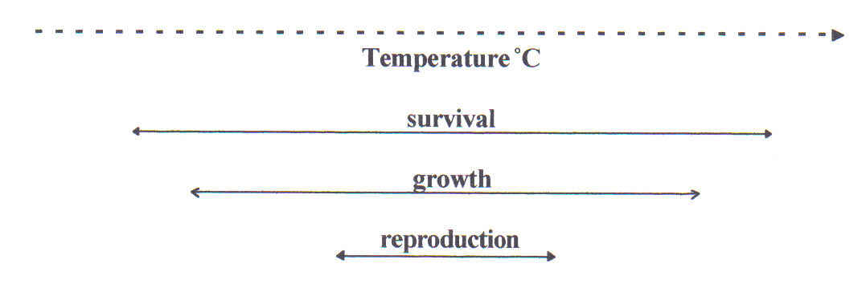
Limits of tolerance
All organisms have upper & lower lethal temp.

Slide 25
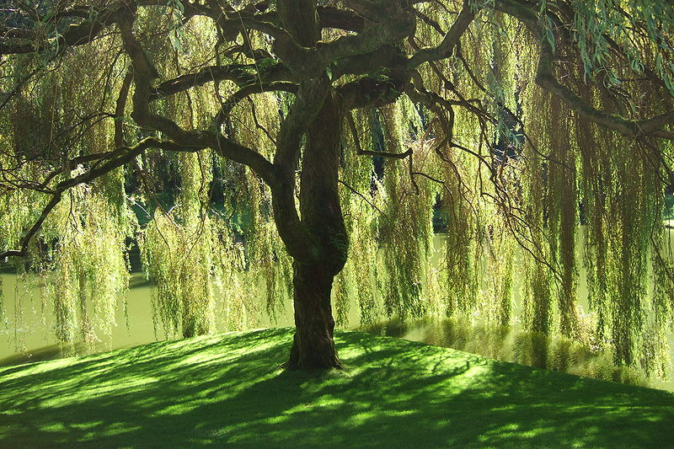
Limits of tolerance
Willow (Salix spp.)
Twigs collected in summer killed at -5°C
Same twigs collected in winter can survive -150 °C!
Hietala et al. (1998) Phytochemistry 47: 1501-1507
Notes:
(image: http://en.wikipedia.org/wiki/File:Bloedel_Reserve_Willow_Tree.jpg)

Slide 26
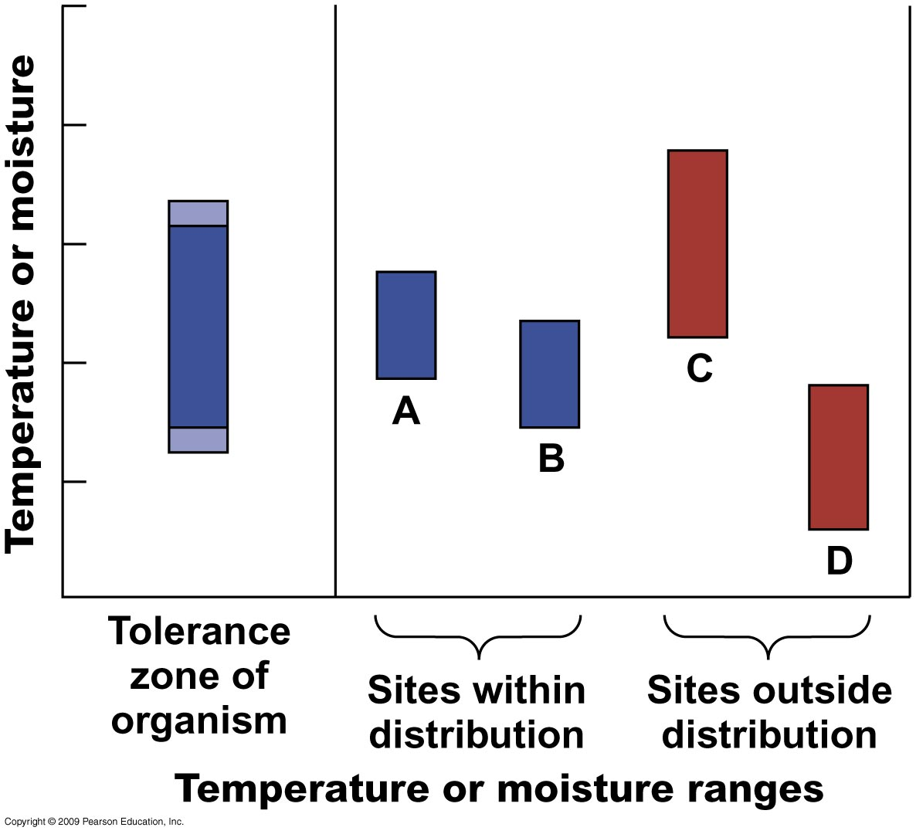
Temperature & moisture as limiting factors
Limits of tolerance
Hypothetical comparison of the tolerance zone of an organism and the temperature or moisture ranges of the microclimates where it lives

Slide 27
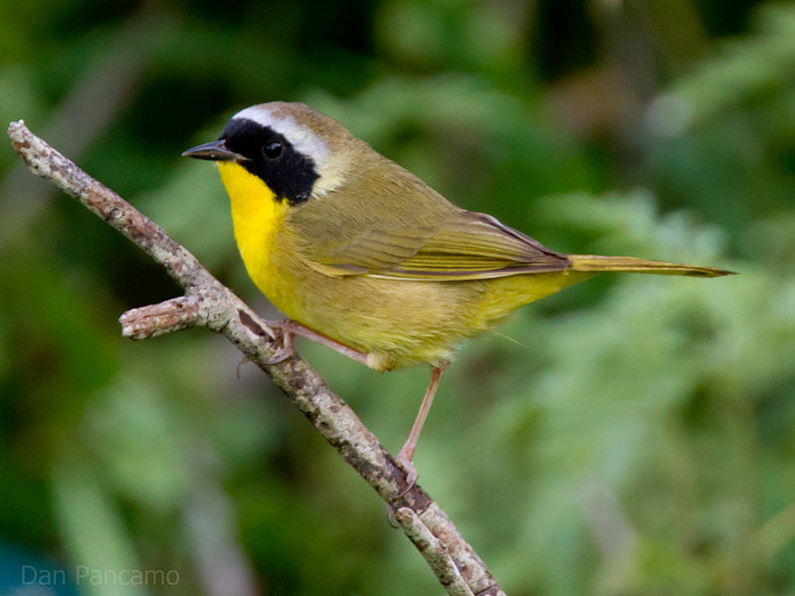
Range limits of endotherms may correlate with climatic variables
Limits of tolerance
Winter distributions of passerine birds in N America correlate with min. Jan. temp.
Direct link to energetic demands associated with cold temps
Common Yellowthroat Geothlypis trichas
Root (1988) Ecology 69: 330-339
Notes:
(Image shows Common Yellowthroat, one of Root’s 1988 study species – from http://en.wikipedia.org/wiki/Common_Yellowthroat)

Slide 28
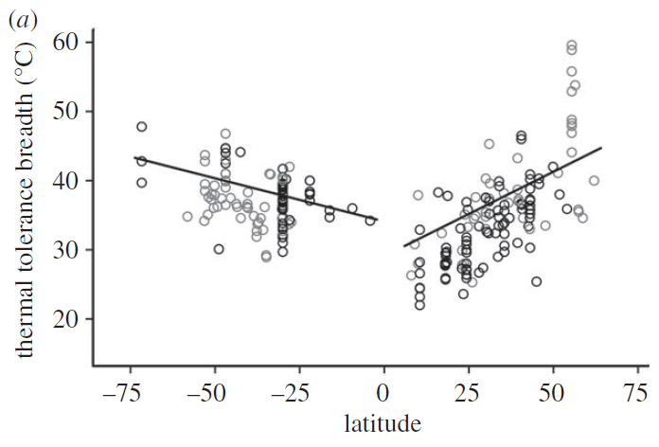
Ectotherms
Limits of tolerance
Terrestrial ectotherms at higher latitudes have wider limits of thermal tolerance
reptiles (128 spp.)
arthropods (81)
amphibians (30)
Sunday et al. (2010) Proc. National Academy of Sciences USA 102(23): 8245-8250

Slide 29
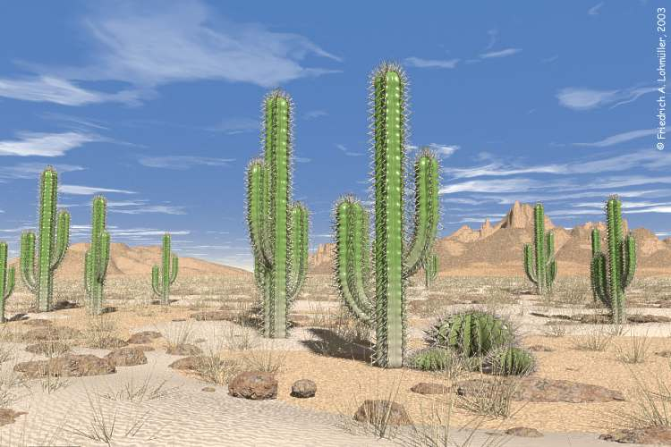
Drought resistance in plants (xerophytes)
Limits of tolerance
Achieved by
Improvement of water uptake by roots
Reduction of water loss
Water storage
Notes:
(Image: greenfieldgeography.wikispaces.com)

Slide 30
Drought
Limits of tolerance
Soil drought
Simple moisture deficiency (as in deserts)
Frost drought
Water present but unavailable (as in tundra in winter)
Both of these can be critical in determining plant species ranges

Slide 31
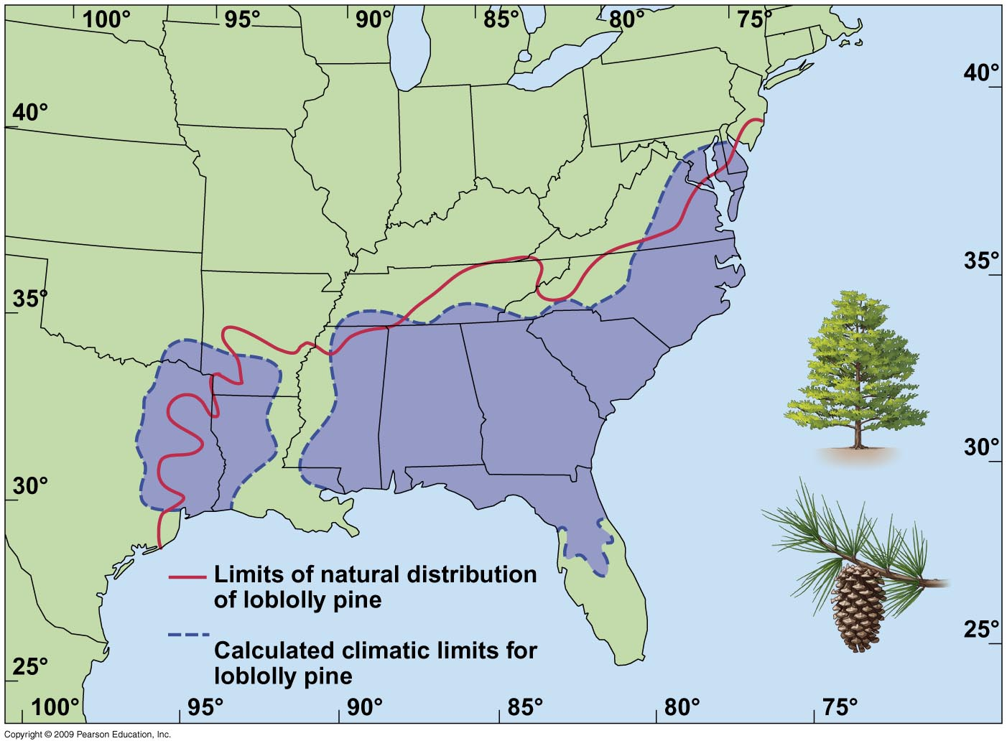
Winter temp & rainfall set N & W limits of loblolly pine
Limits of tolerance
Natural distribution limits (red line) and calculated climatic limits (blue dotted line) of loblolly pine (Pinus taeda) in SW USA
Hocker (1956) Ecology 37: 824-834

Slide 32
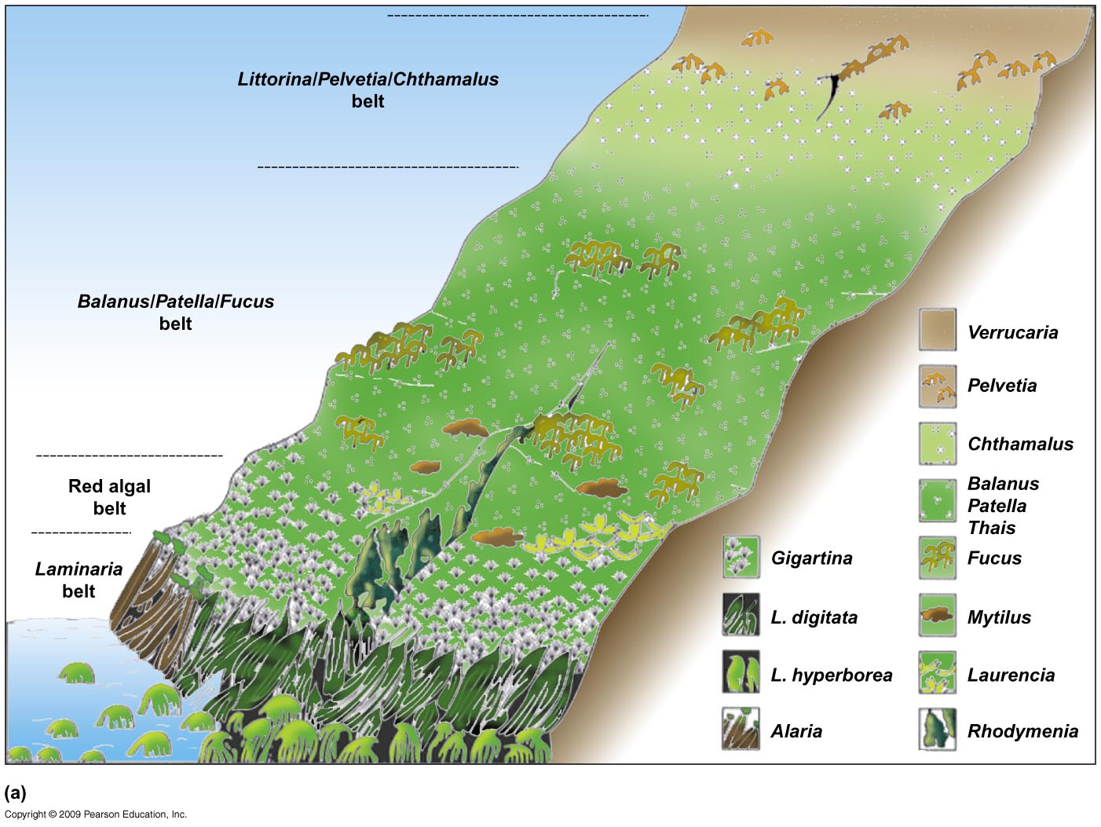
Intertidal zones show clear distributional boundaries
Limits of tolerance
NW Scotland & NW Ireland

Slide 33
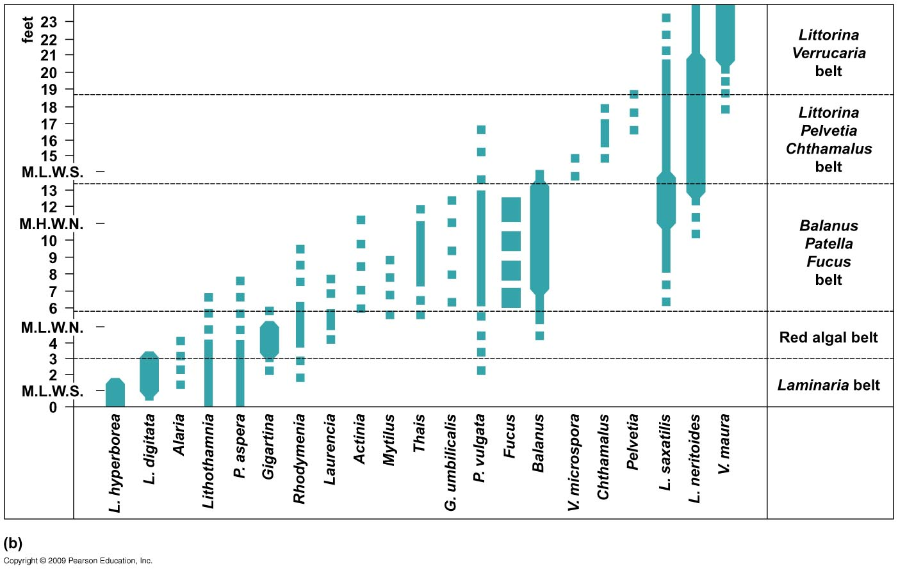
Intertidal zones show clear distributional boundaries
Limits of tolerance
M.H.W.S.
MHWS = mean high water, spring (i.e. max) tide
MLWN = mean low water, neap (i.e. min) tide, etc
Bar width is proportional to abundance

Slide 34
Limits to Distributions: Abiotic Factors
Part i
Climate
Temperature
Microclimate
Part ii
Climate
Moisture
Topography
Climate change
Part iii
Limits of tolerance
Part iv
Light

Slide 35
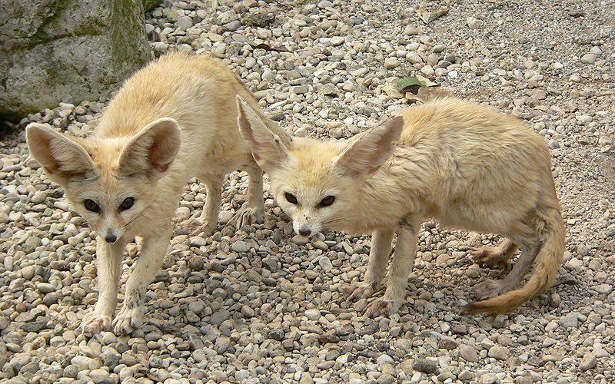
Light
A cue for timing of daily & seasonal rhythms (photoperiodism) in animals & plants, e.g.
Nocturnal desert mammals
Breeding seasons (day-length changes)
Essential for photosynthesis
V. inefficient (<1%)
Great diversity in photosynthetic response to light intensity
Vulpes zerda Fennec fox
Image: Umberto Salvagnin

Slide 36
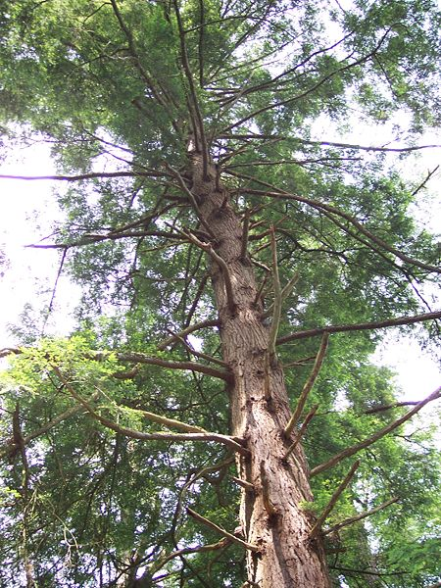
Shade tolerance is not fixed for a species
Varies with
Plant age
Microclimate
Geographical area
Shade tolerant plants
Lower photosynthetic rates → lower growth rates (& seedlings have lower metabolic rates)
e.g. eastern hemlock
Image: Tim Kiser
Notes:
Image: E hemlock Tsuga canadensis, Tim Kiser (http://en.wikipedia.org/wiki/File:Cathedral_State_Park_West_Virginia_Eastern_Hemlock.jpg)
P.92

Slide 37
Adaptations are compromises
Organisms cannot do everything in the best possible way
Adaptations for one habitat may make it v. difficult to live in a different one

Slide 38
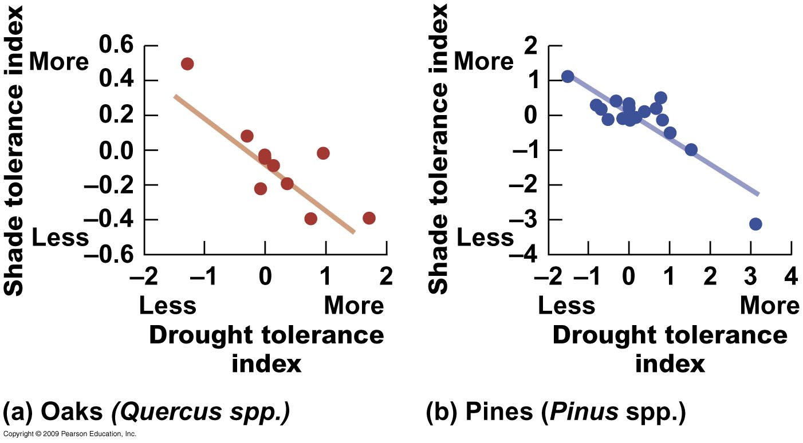
Trade-off between shade tolerance & drought tolerance
Valladares & Niinemets (2008) Ann. Rev. Ecology Evolution & Systematics 39: 237-257

Slide 39
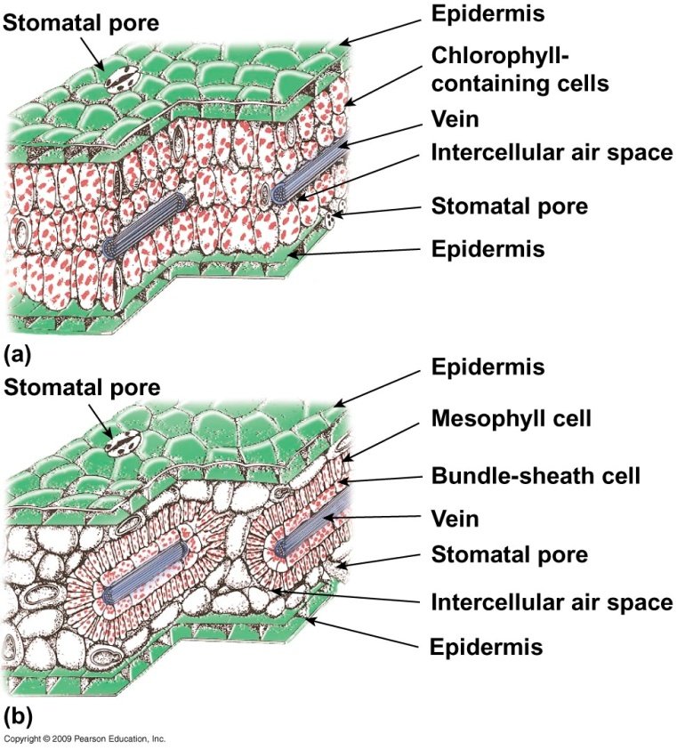
Trade-offs are influenced by a plant’s photosynthetic strategy
C₃ pathway
Calvin-Benson cycle
CO₂ converted to a 3C molecule
The ancestral form of photosynthesis
C₄ pathway
CO₂ first converted to 4C molecules
C₄ plants more adaptable (can also use C₃)
C₃
C₄

Slide 40
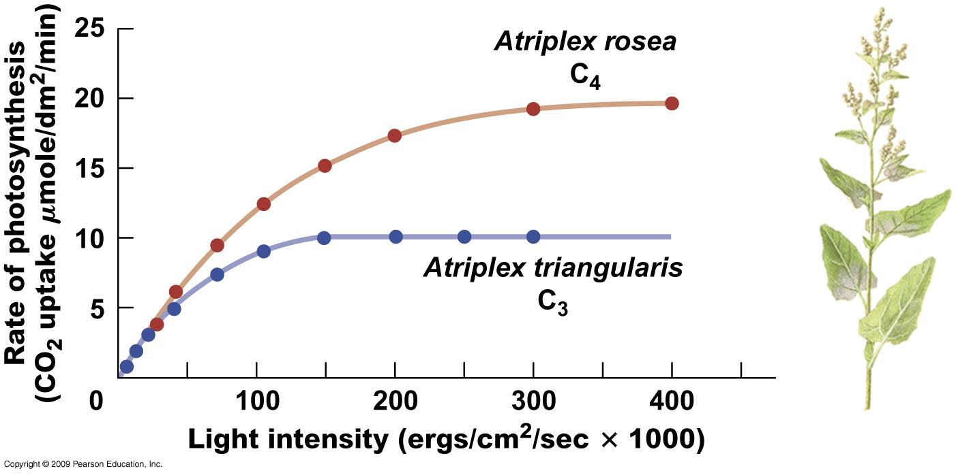
C₄ plants are more efficient than C₃
C₄ is more efficient for -
utilizing CO₂ at low concentrations
recycling CO₂ produced in respiration
rapidly translocating starches to other parts of leaf

Slide 41
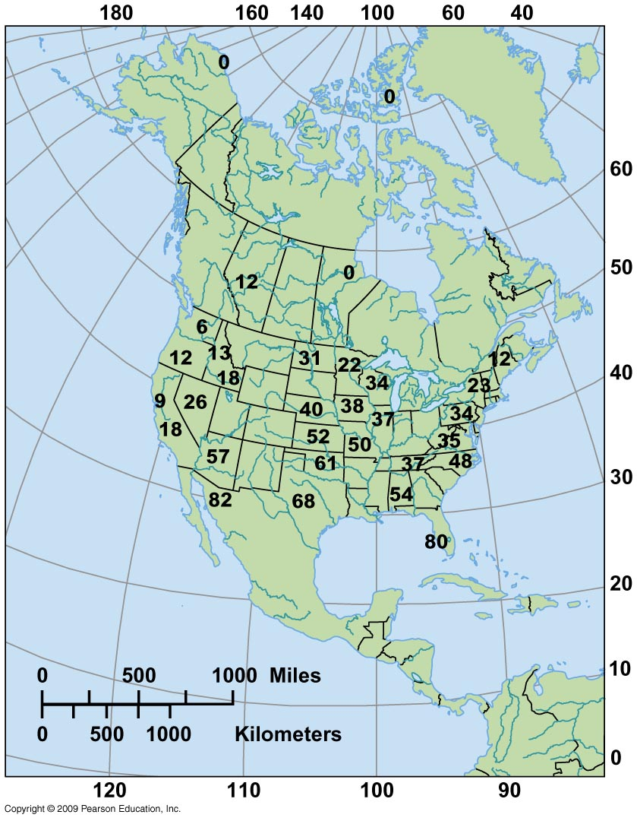
C₄ plants dominate in tropical areas
Percentage of C₄ species in grass floras of 32 regions

Slide 42
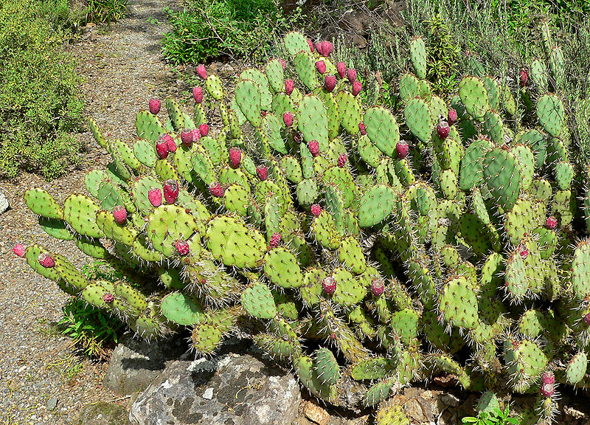
Trade-offs are influenced by a plant’s photosynthetic strategy
C₃ pathway
C₄ pathway
CAM (crassulacean acid metabolism) pathway
Desert succulents (e.g. Opuntia cacti)
Open stomata for taking in CO₂ at night
Can switch to C₃ during the day
Opuntia littoralis
Image: Stan Shebs
Notes:
(Image: Stan Shebs http://en.wikipedia.org/wiki/File:Opuntia_littoralis_var_vaseyi_4.jpg)

Slide 43
A plant’s distribution is not only determined by its photosynthetic pathway (of course!)
Interaction with other factors
e.g. mineral nutrients, soil texture, climate
So in many regions C₄ plants do not displace C₃

Slide 44
Limits to Distributions: Abiotic Factors
Part i
Climate
Temperature
Microclimate
Part ii
Climate
Moisture
Topography
Climate change
Part iii
Limits of tolerance
Part iv
Light

Slide 45
References (those in bold especially recommended)
Dullinger, S., et al. (2012). Extinction debt of high-mountain plants under twenty-first-century climate change. Nature Climate Change, 2(8), 619-622.
Engler, R., et al. (2011). 21st century climate change threatens mountain flora unequally across Europe. Global Change Biology, 17(7), 2330-2341.
Harley, C. D., & Helmuth, B. S. (2003). Local-and regional-scale effects of wave exposure, thermal stress, and absolute versus effective shore level on patterns of intertidal zonation. Limnology and Oceanography, 48(4), 1498-1508.
Hietala, T., et al. (1998). Fatty acid and alkane changes in willow during frost-hardening. Phytochemistry. 47(8), 1501-1507.
Hocker, H.W.,Jr. (1956). Certain Aspects of Climate As Related to the Distribution of Loblolly Pine. Ecology. 37(4), 824-834.
Iverson, L. R., & Prasad, A. M. (1998). Predicting abundance of 80 tree species following climate change in the eastern United States. Ecological Monographs, 68(4), 465-485.
Joshi, J., et al. (2001). Local adaptation enhances performance of common plant species. Ecology Letters. 4(6), 536-544.
Korner, C. & Paulsen, J. (2004). A world-wide study of high altitude treeline temperatures. Journal of Biogeography. 31(5), 713-732.
Krebs, C. (2014). Ecology: the experimental analysis of distribution and abundance. London: Benjamin Cummings. Chapter 6 and references therein.
Pincebourde, S., & Woods, H. A. (2012). Climate uncertainty on leaf surfaces: the biophysics of leaf microclimates and their consequences for leaf‐dwelling organisms. Functional Ecology, 26(4), 844-853.
Root, T. (1988). Energy Constraints on Avian Distributions and Abundances. Ecology. 69(2), 330-339.
Sage, R.F. & McKown, A.D. (2006). Is C(4) photosynthesis less phenotypically plastic than C(3) photosynthesis? Journal of experimental botany. 57(2), 303-317.
Sunday, J.M., et al. (2010). Global analysis of thermal tolerance and latitude in ectotherms. Proceedings of the Royal Society B-Biological Sciences. 278(1713), 1823-1830.
Thuiller, W., et al. (2005). Climate change threats to plant diversity in Europe. Proceedings of the National Academy of Sciences of the United States of America. 102(23), 8245-8250.
Turesson, G. (1930). The Selective Effect Of Climate Upon The Plant Species. Hereditas. 14(2), 99-152.
Valladares, F. & Niinemets, U. (2008). Shade Tolerance, a Key Plant Feature of Complex Nature and Consequences. Annual Review of Ecology Evolution and Systematics. 39, 237-257.
Wu, S., et al. (2010). Patterns of plant invasions in China: Taxonomic, biogeographic, climatic approaches and anthropogenic effects. Biological Invasions. 12(7), 2179-2206.

